Slide 1

AAD & DAD
Algorithm-aided Design
Data-aided Design
2021.10.29

Slide 2
The EVOLUTION OF AN ARCHITECT
Analog
CAD
DAD
Generative
– Drawing Board
– Computer aided Design
– Data aided Design
– Algorithm led Design.

Slide 3
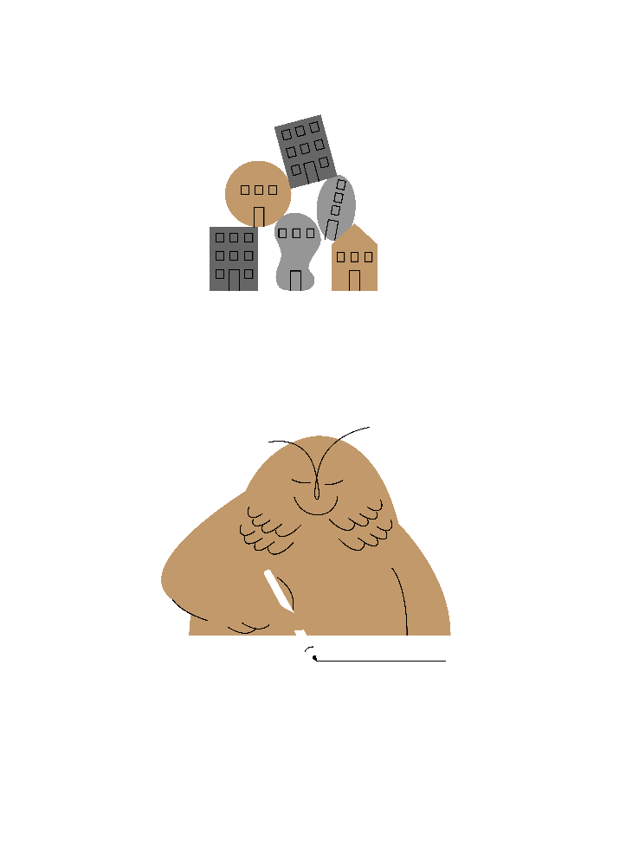
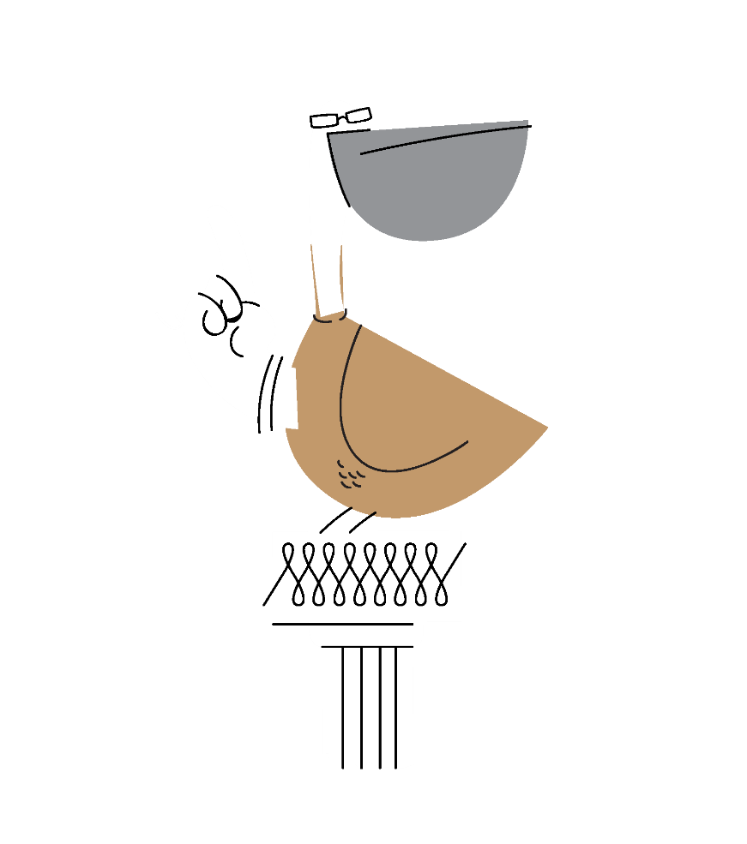
The impact of the tool
HOW WE WORK
HOW WE THINK
Product Development
Development Process

Slide 4
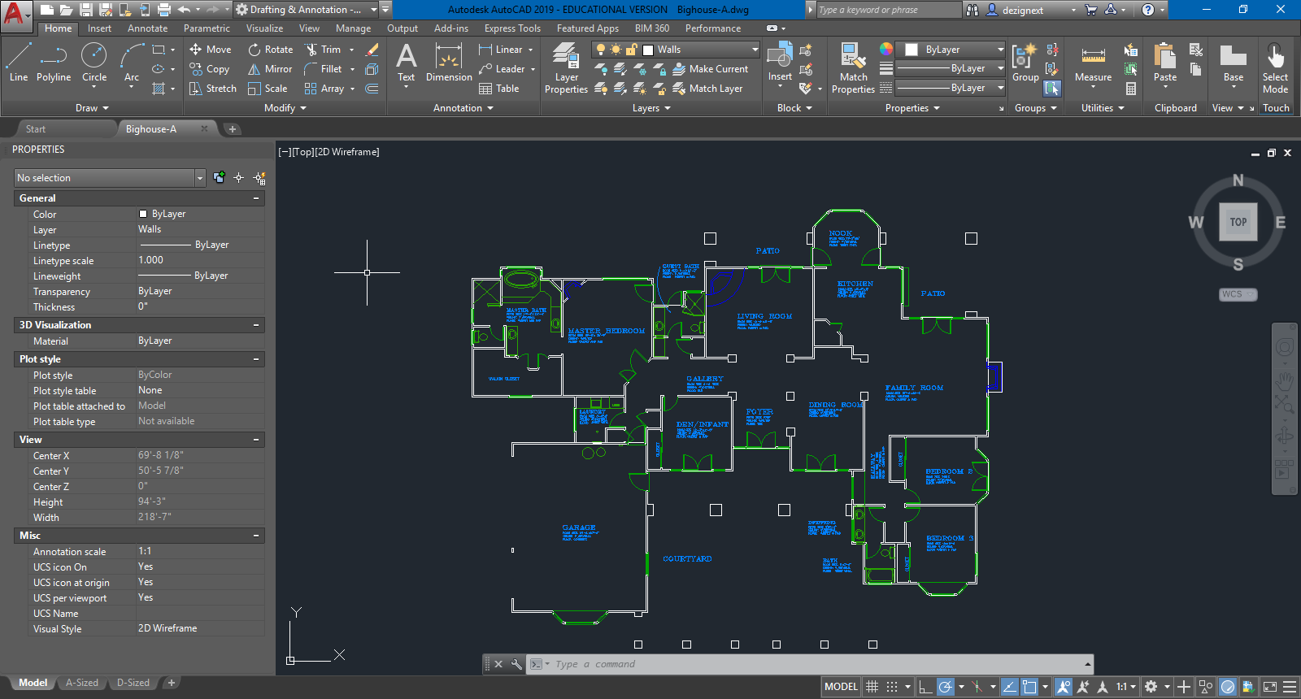
Save
Scale
Undo
Copy
Print
Archive
Modify
Space

Slide 5
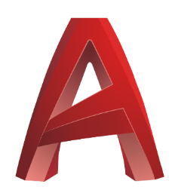
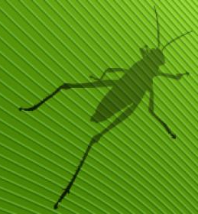
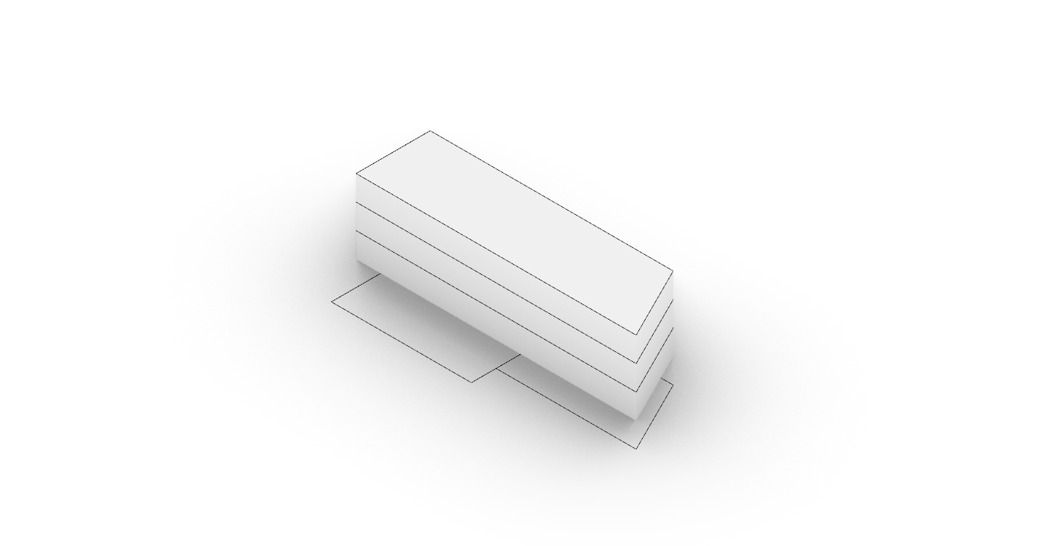
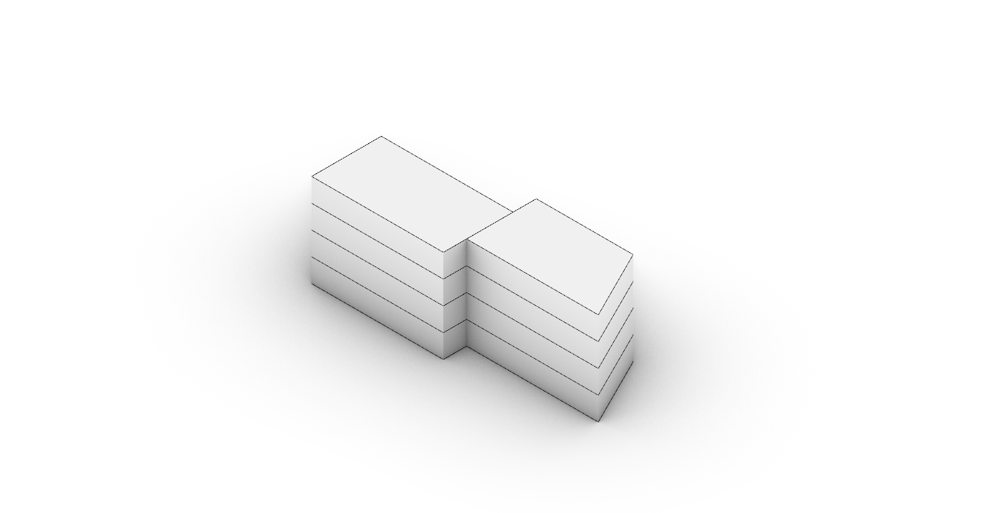
Click-Based
Direct Modelling
Nonadaptive Geometry
Unanalysable Outcome
Non-recyclable Product
Algorithm Based
Indirect Modelling
Adaptive Geometry
Analysable Outcome
Recyclable Product

Slide 6
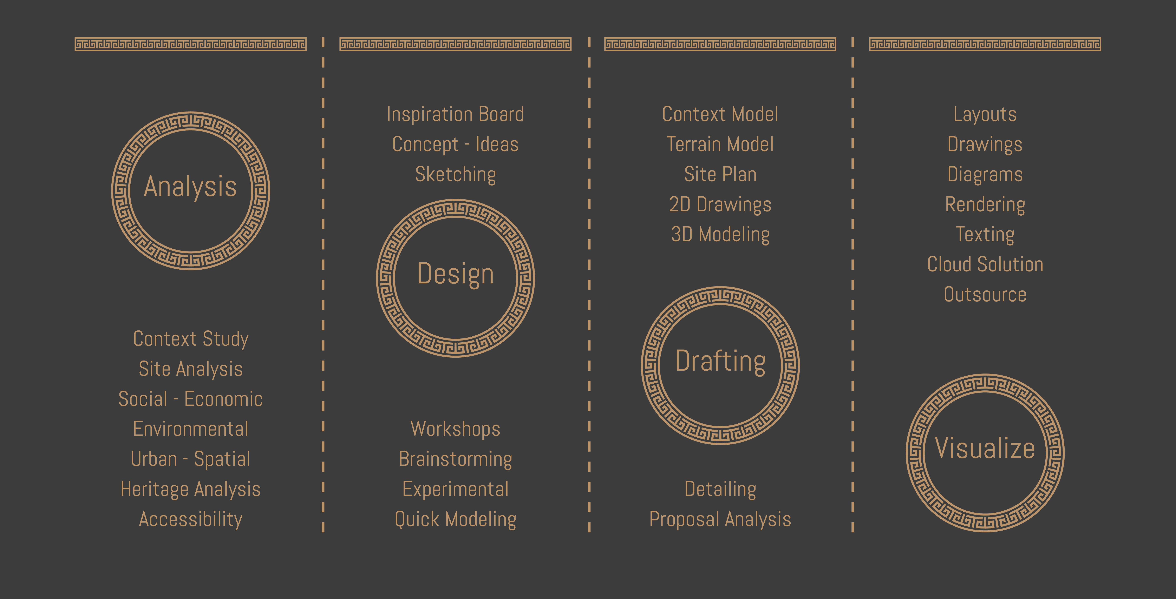
Project development
Linear Staging Process

Slide 7
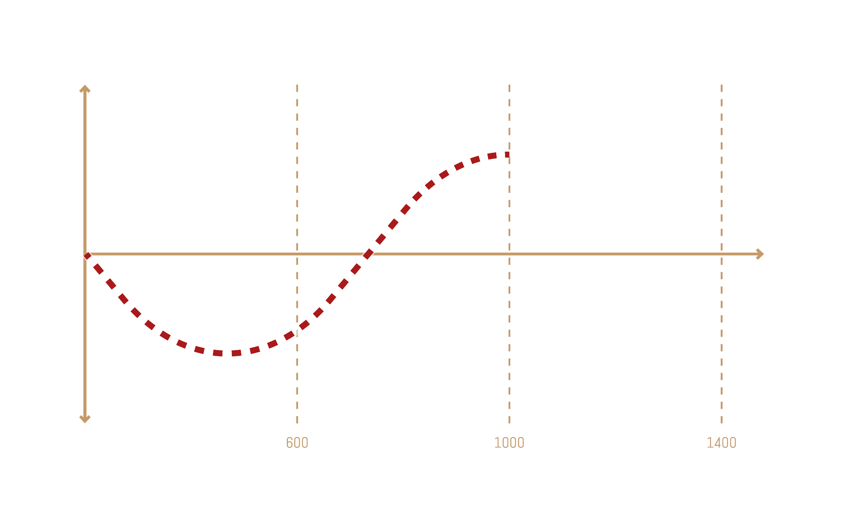
Output Quality
Project Budget
Depth of Study

Slide 8
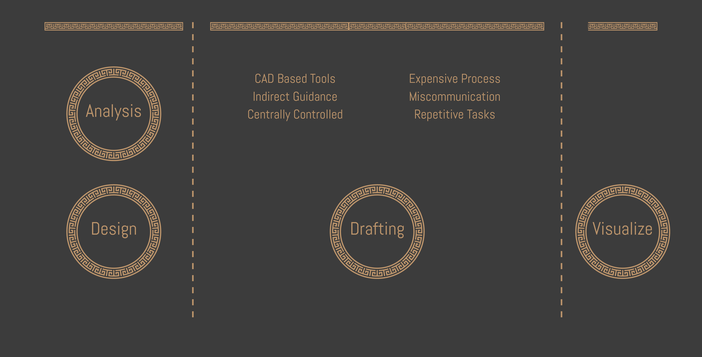
Project budget
CAD-based Process

Slide 10
Project development
Linear Staging Process

Slide 11
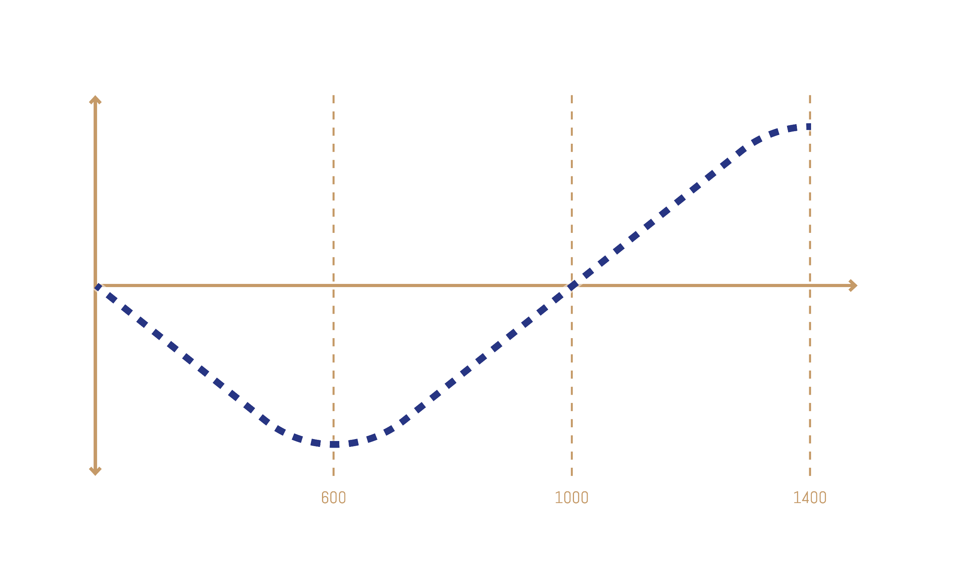
Output Quality
Project Budget
Depth of Study

Slide 12
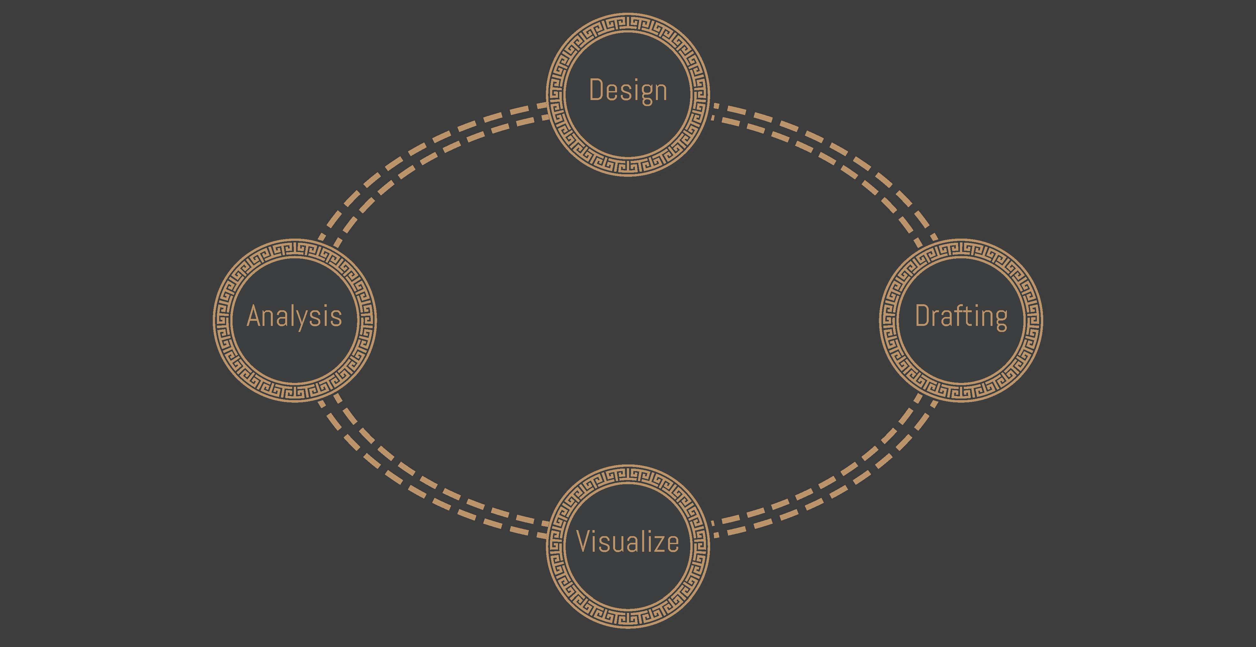
Project development
Circular Process

Slide 14
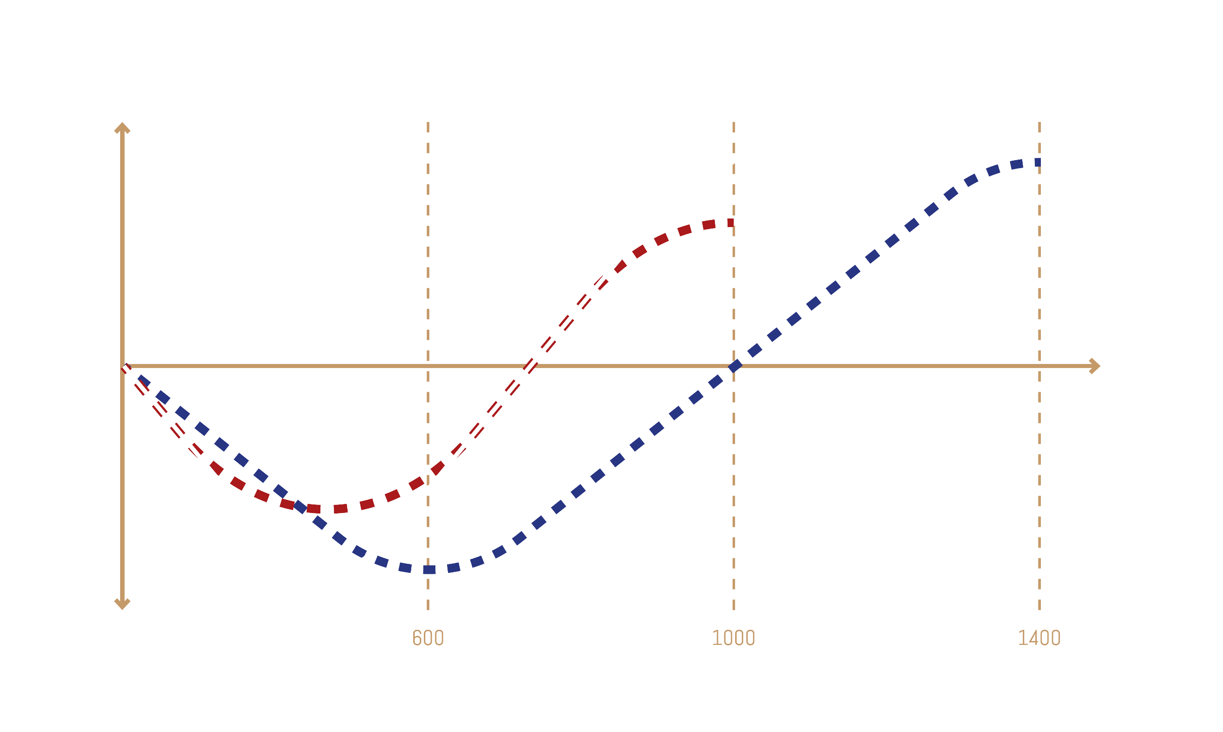
Output Quality
Project Budget
Depth of Study

Slide 15
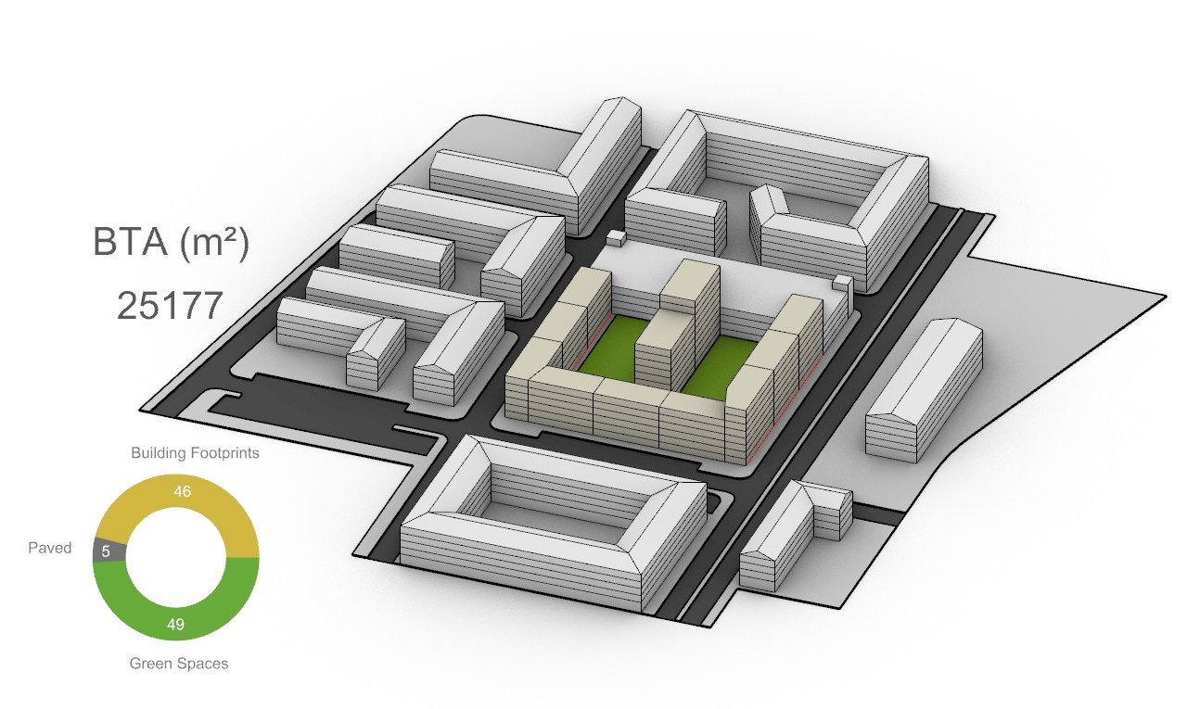
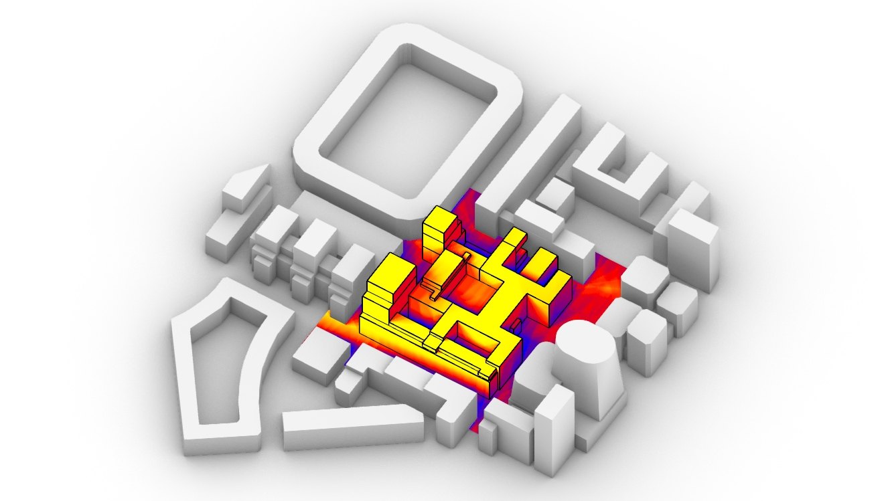
AAD & DAD
PROCESS AUTOMATION
ANALYTIC SYSTEM
Drafting & Design Tools
Data Aided Approach

Slide 16
AAD & DAD
PROCESS AUTOMATION
ANALYTIC SYSTEM
Drafting & Design Tools
Data Aided Approach

Slide 17
AAD & DAD
PROCESS AUTOMATION
ANALYTIC SYSTEM
= Higher Margin + Operational Scaling
= More Accurate + Higher Quality

Slide 18
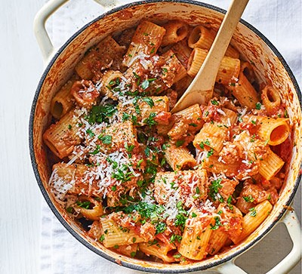
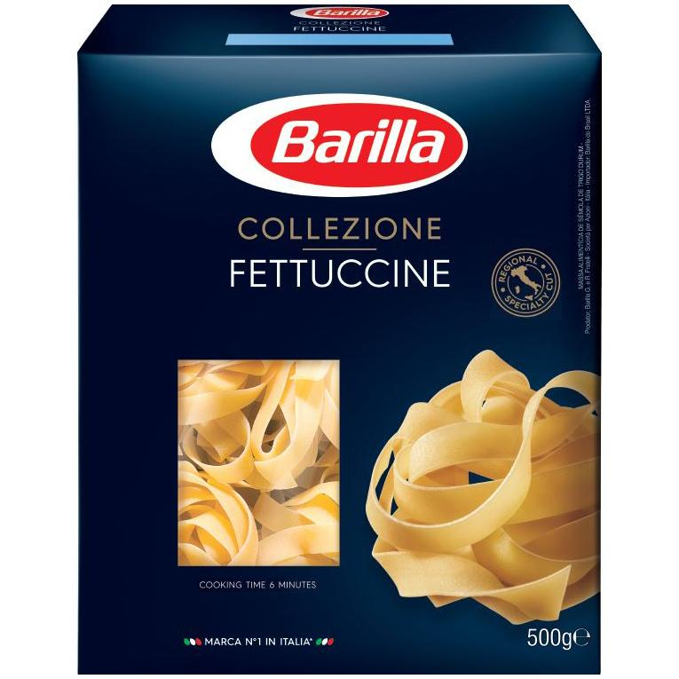
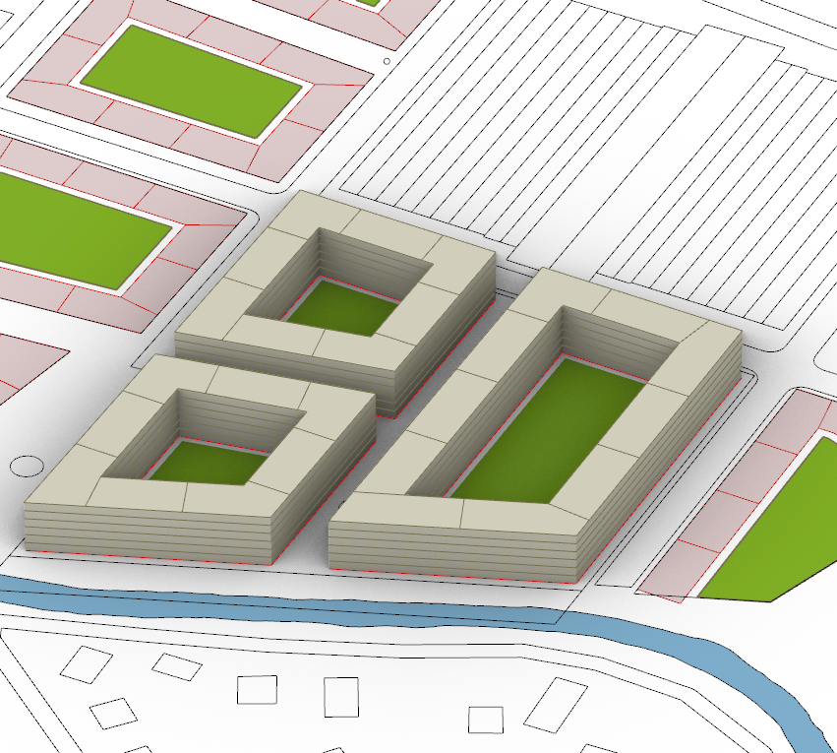
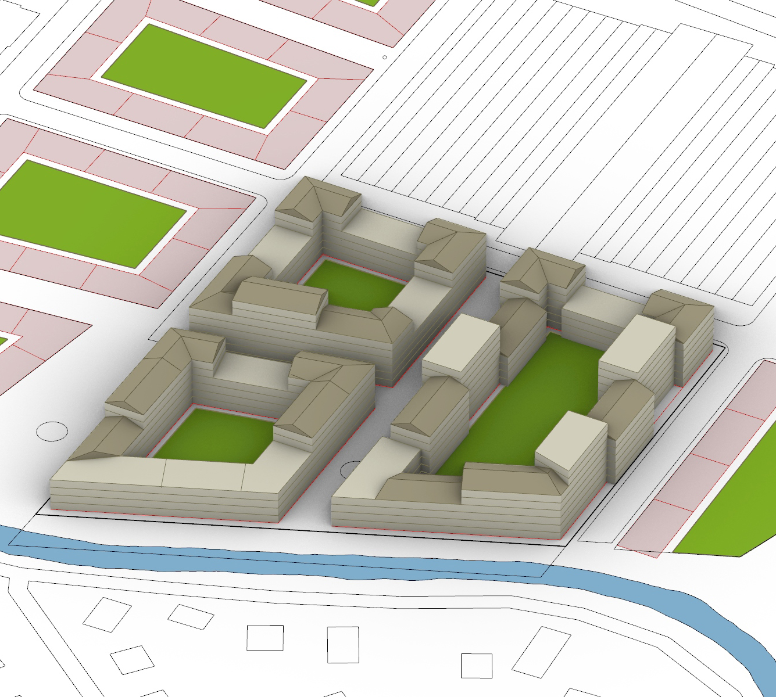
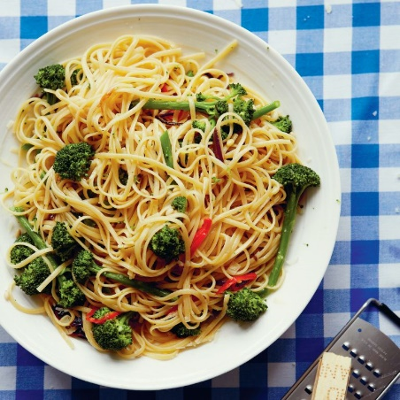
AAD & DAD
PROCESS AUTOMATION
ANALYTIC SYSTEM
Recyclable ≠ Repetitive
Adaptive ≠ Predictive

Slide 19
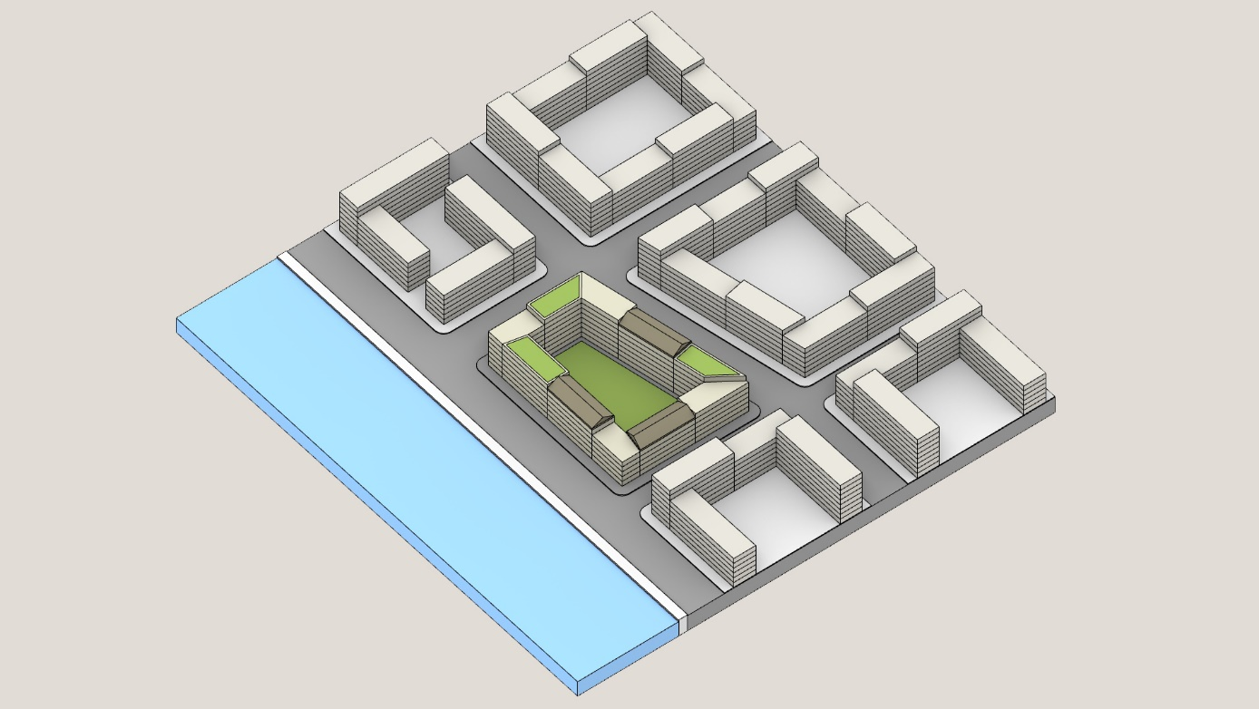
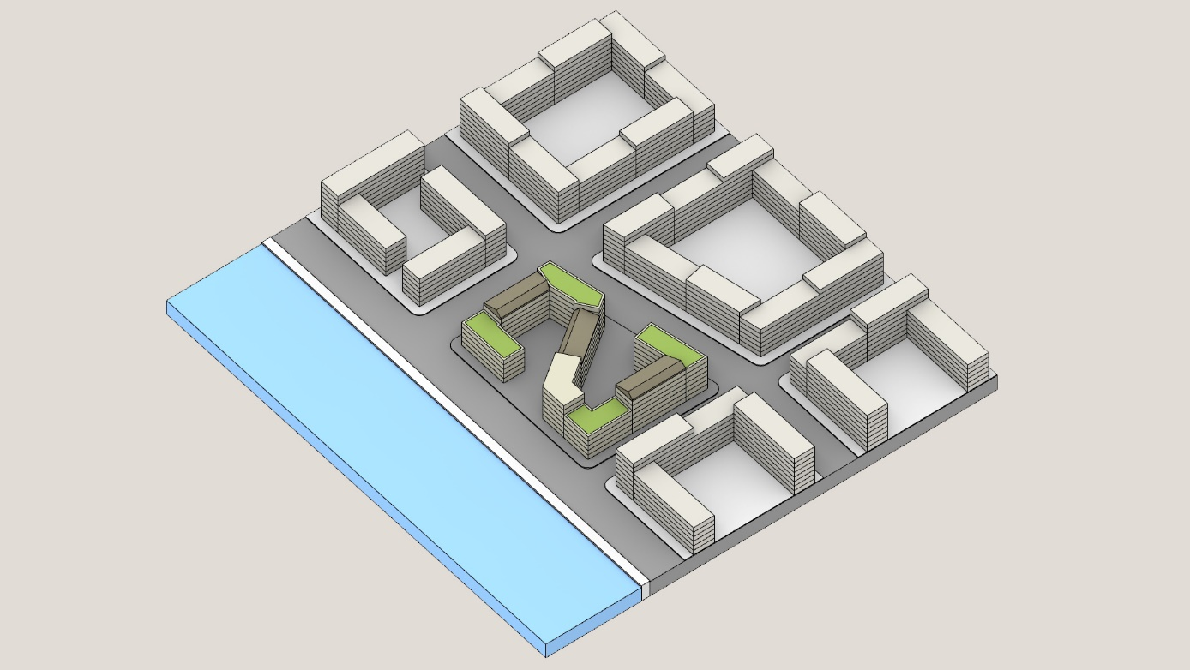
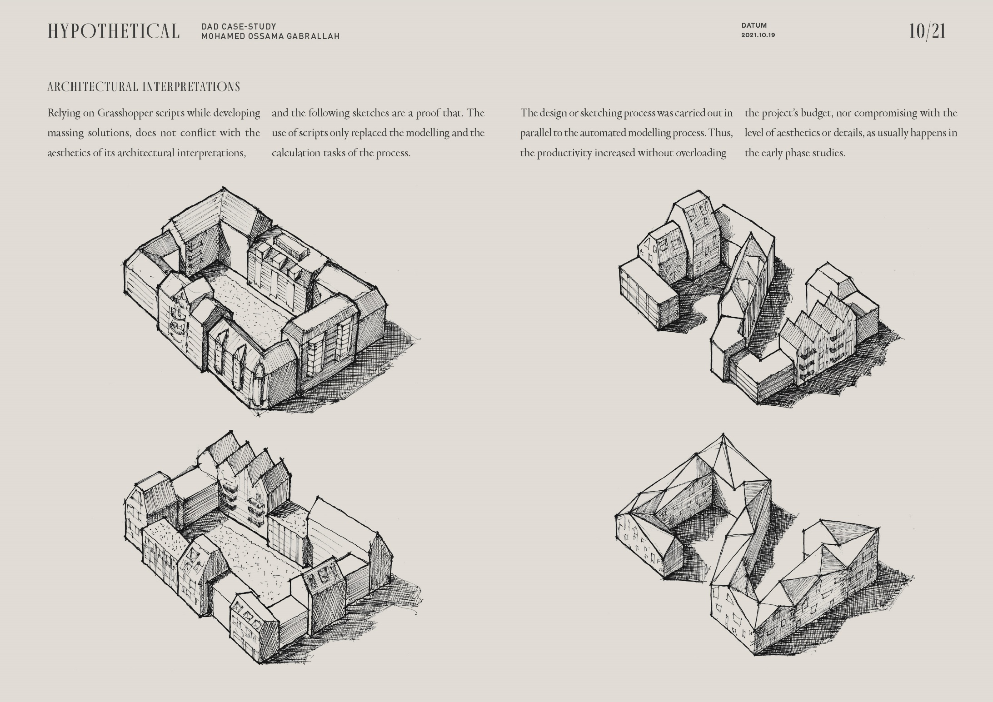
AAD & DAD
Not for A-Z

Slide 20
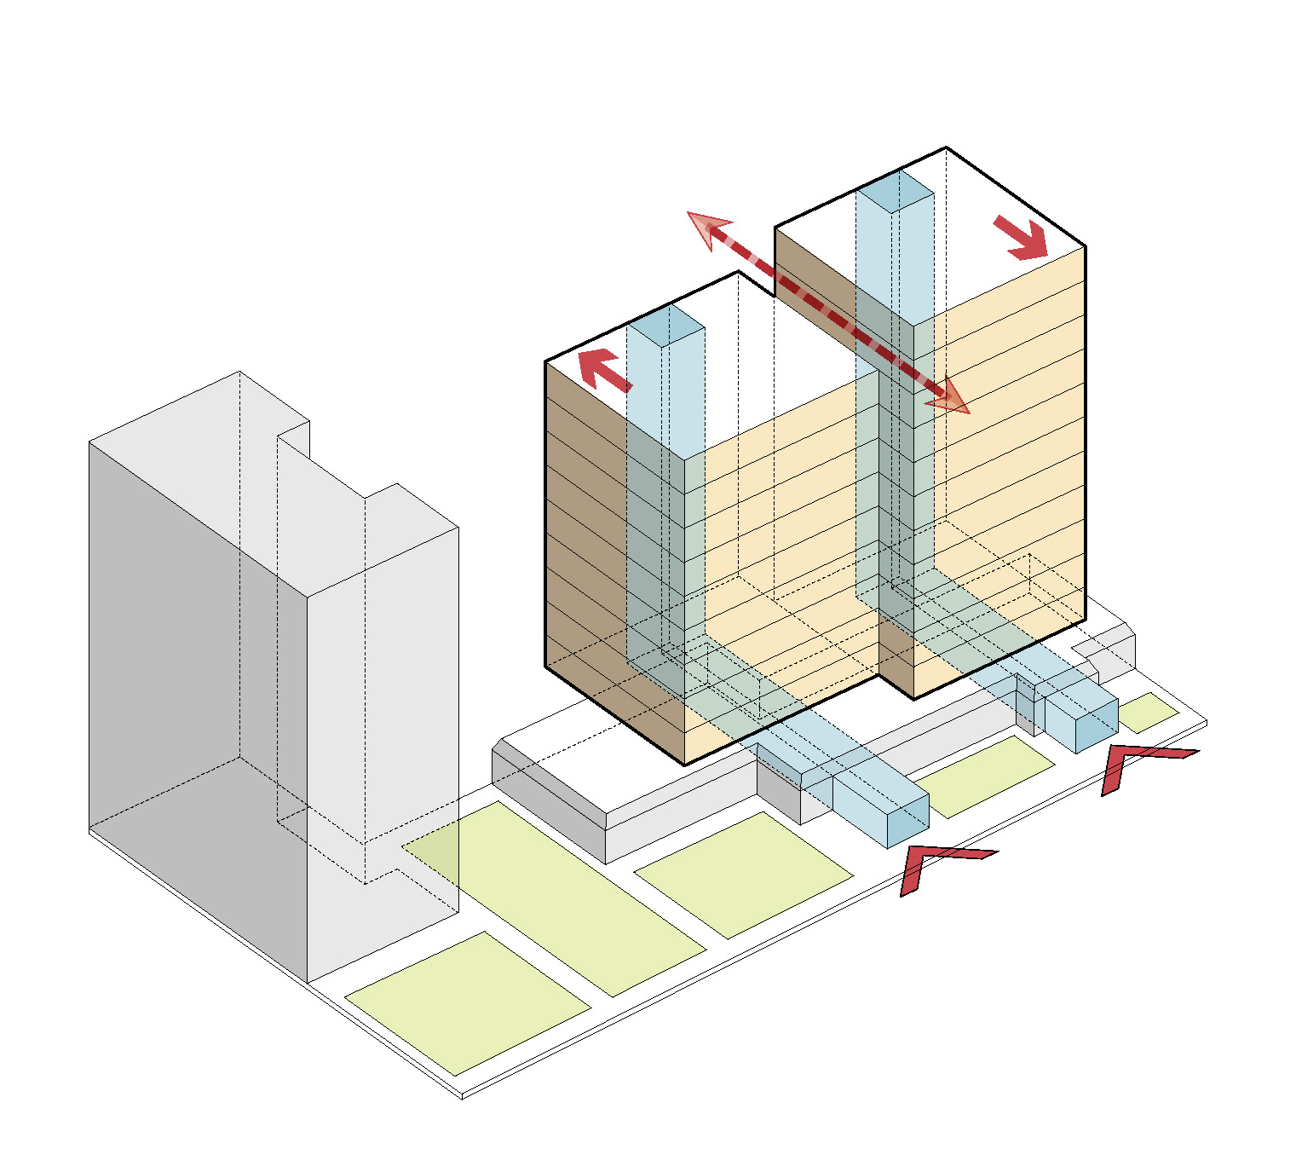
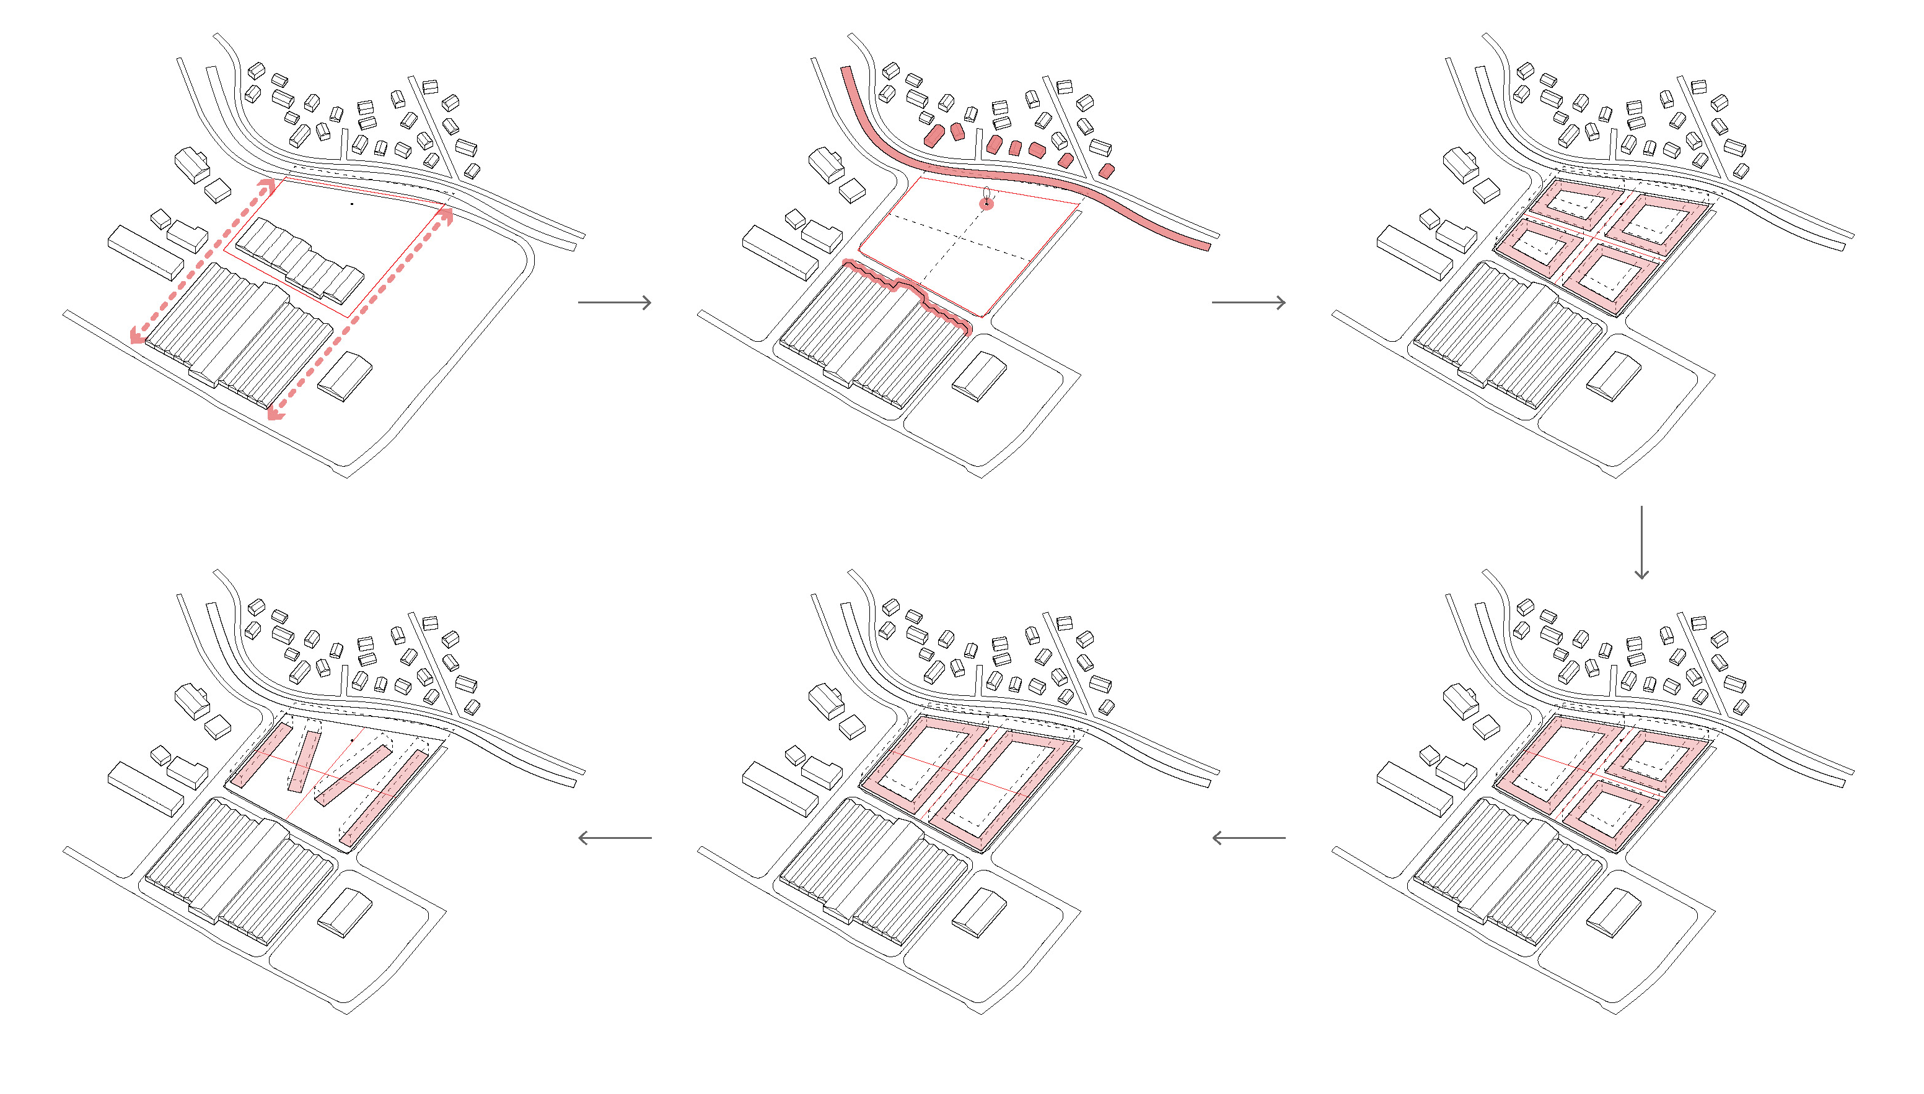
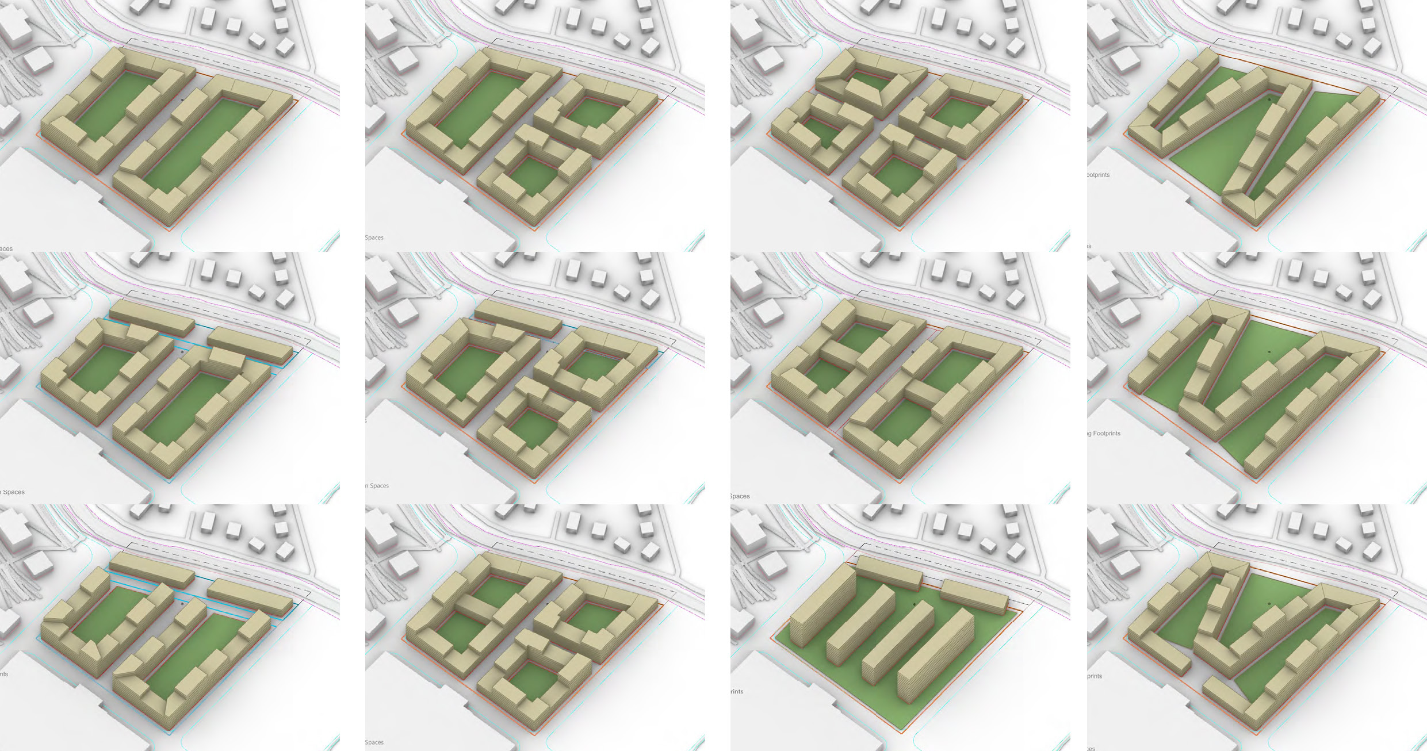
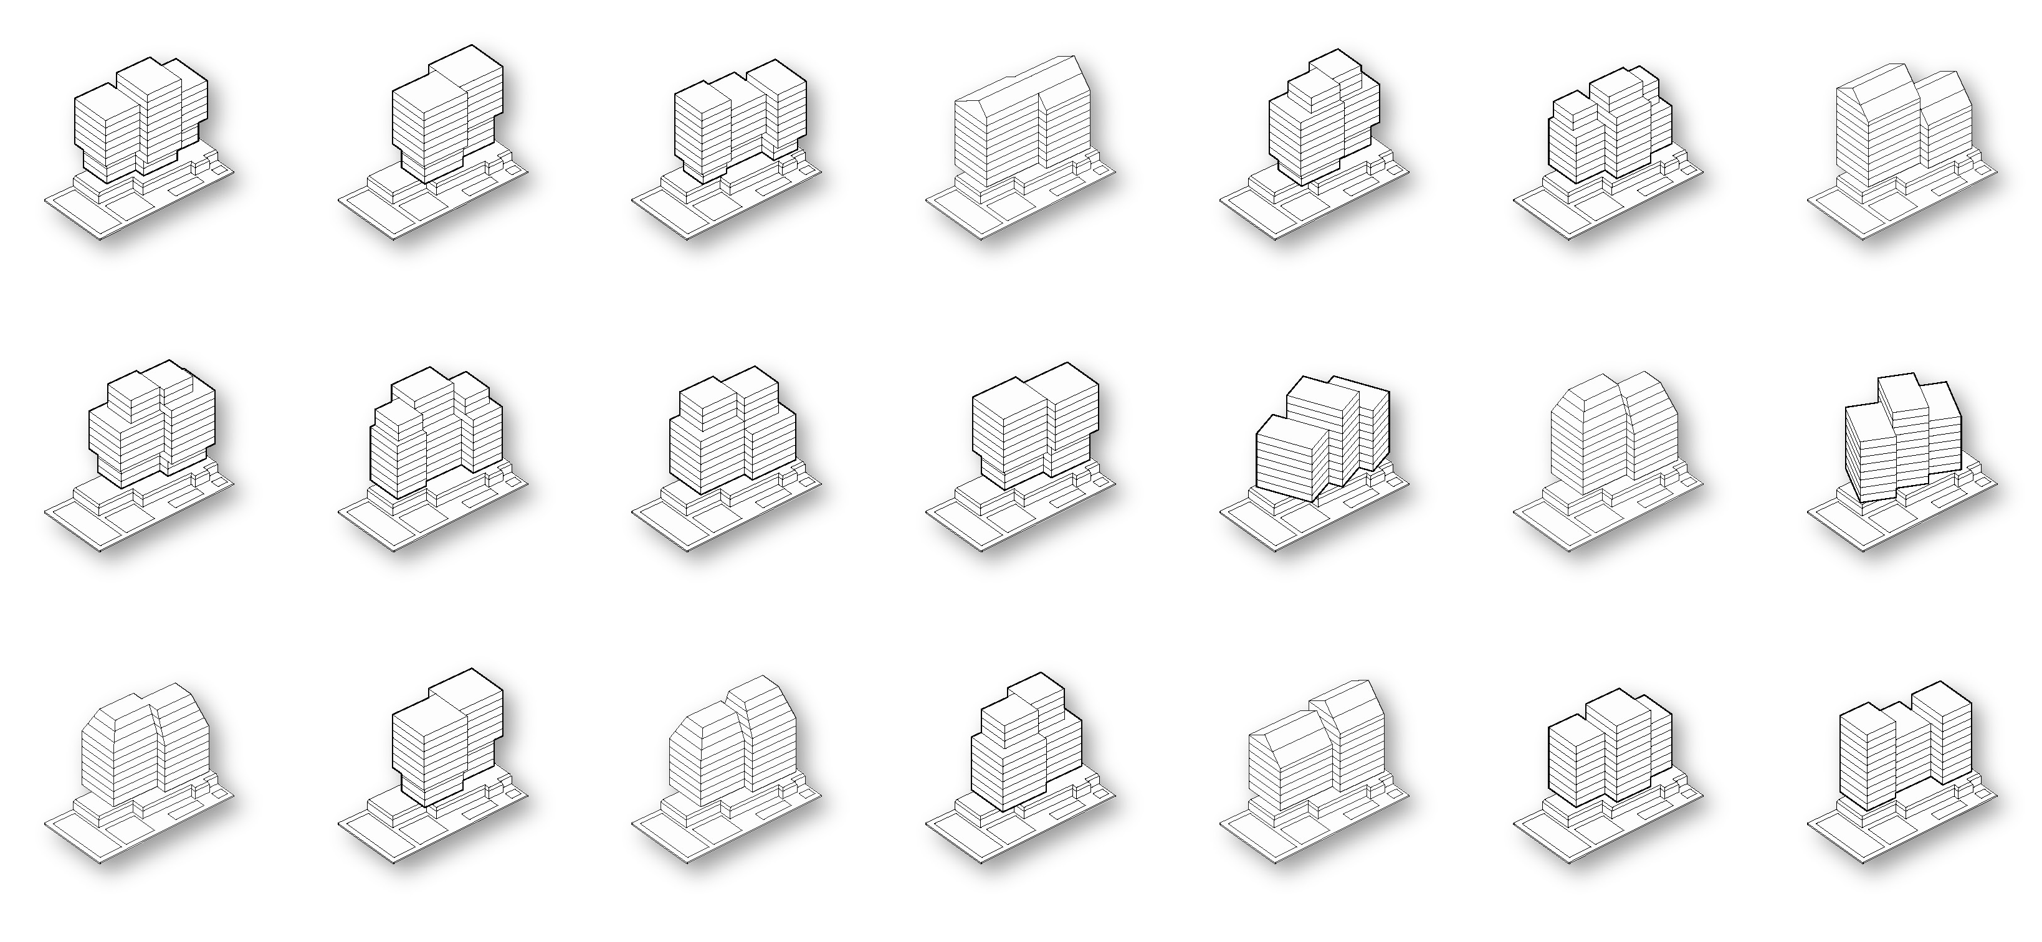
1 approach
100 Sketches

Slide 21
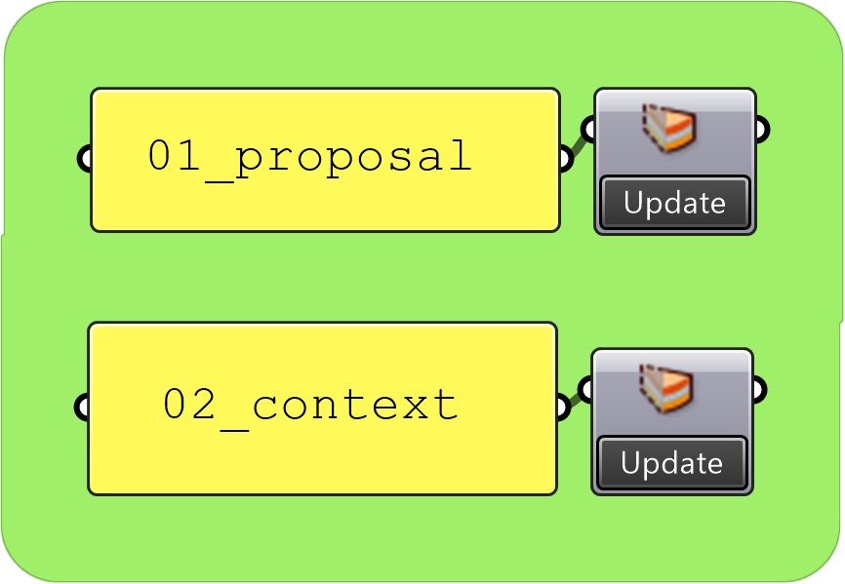
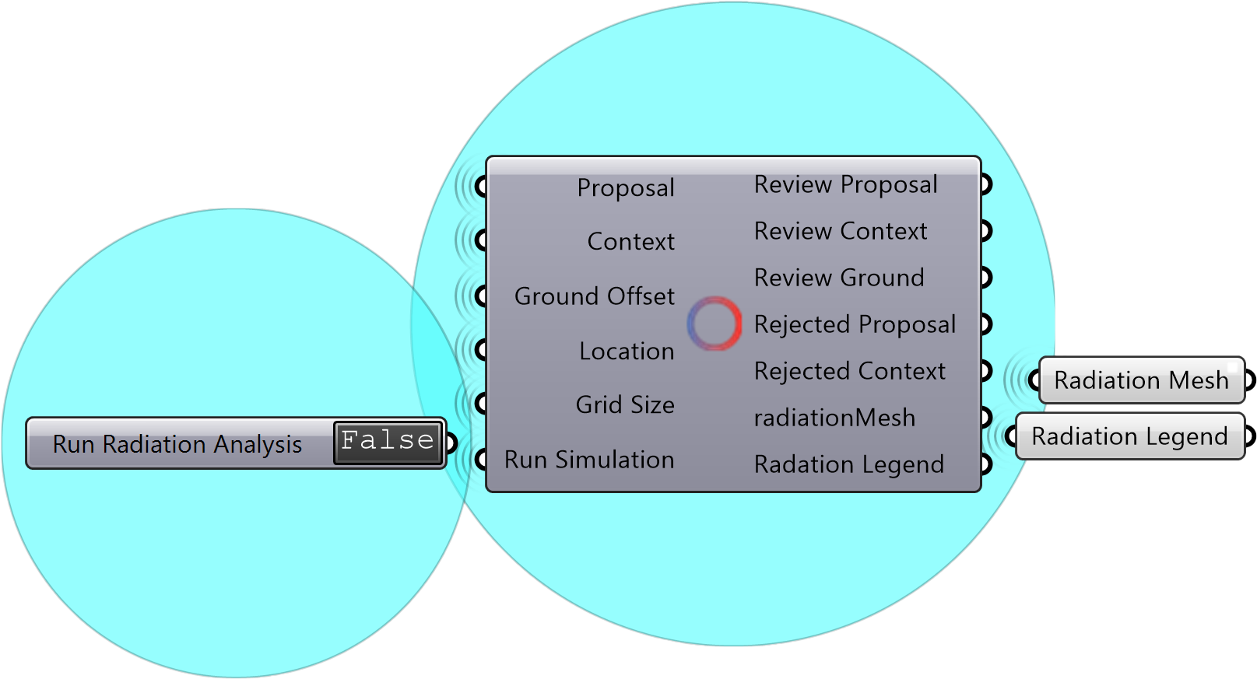
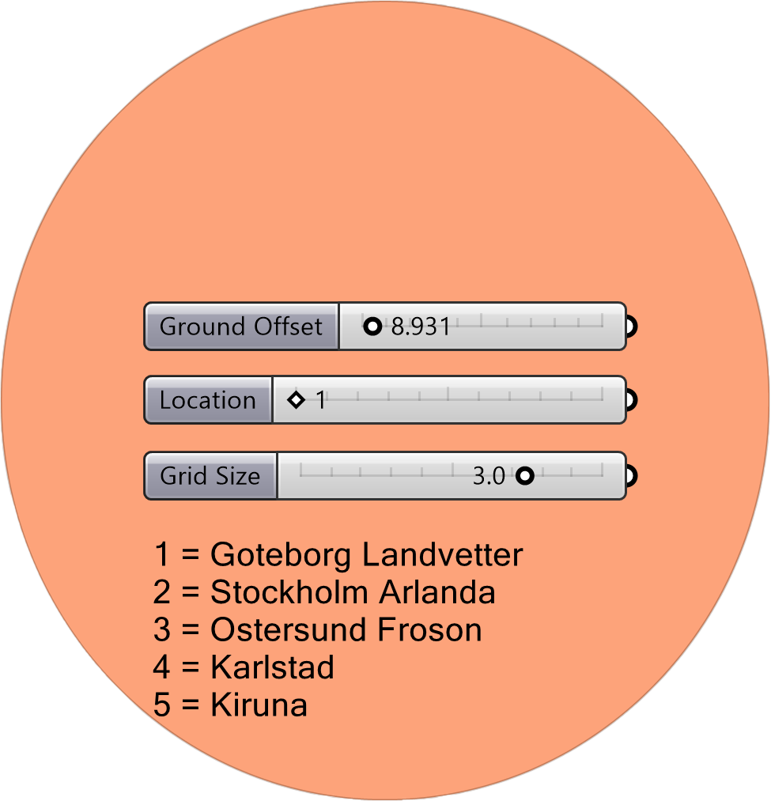
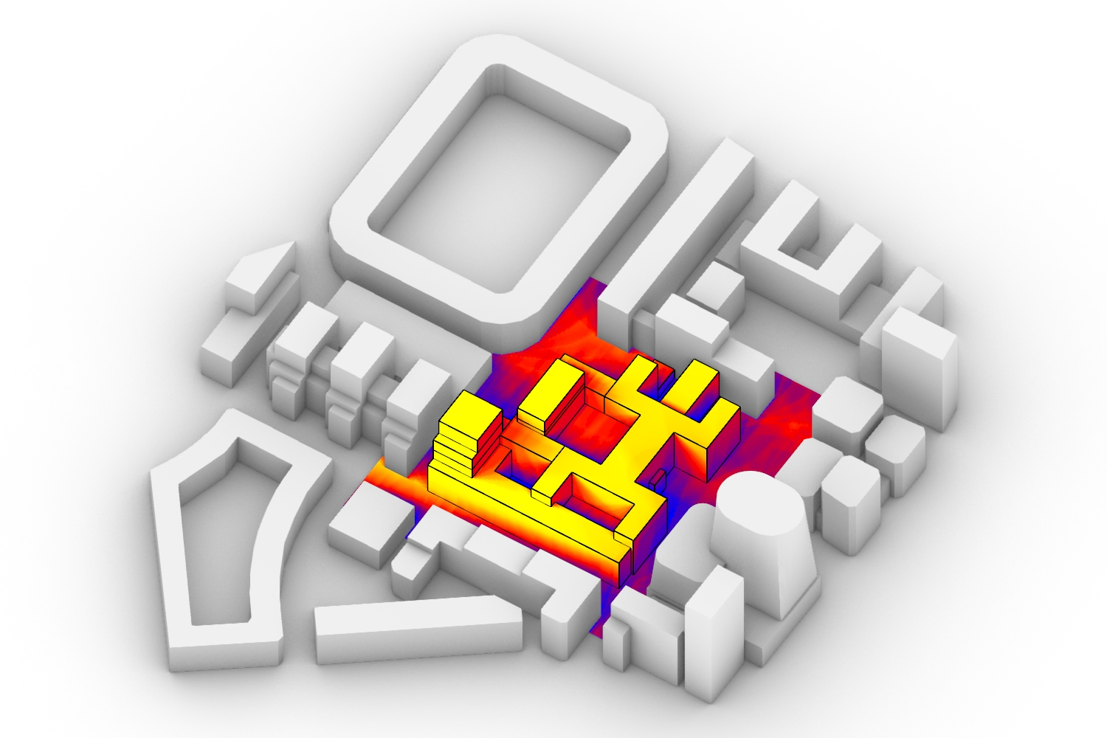
AAD & DAD
COMPLEX SCRIPTS
USER FRIENDLY TOOLS
Grasshopper + Rhino
Basic Knowledge of Rhino
3
Run
1
Import
4
2
Enjoy
Choose

Slide 22
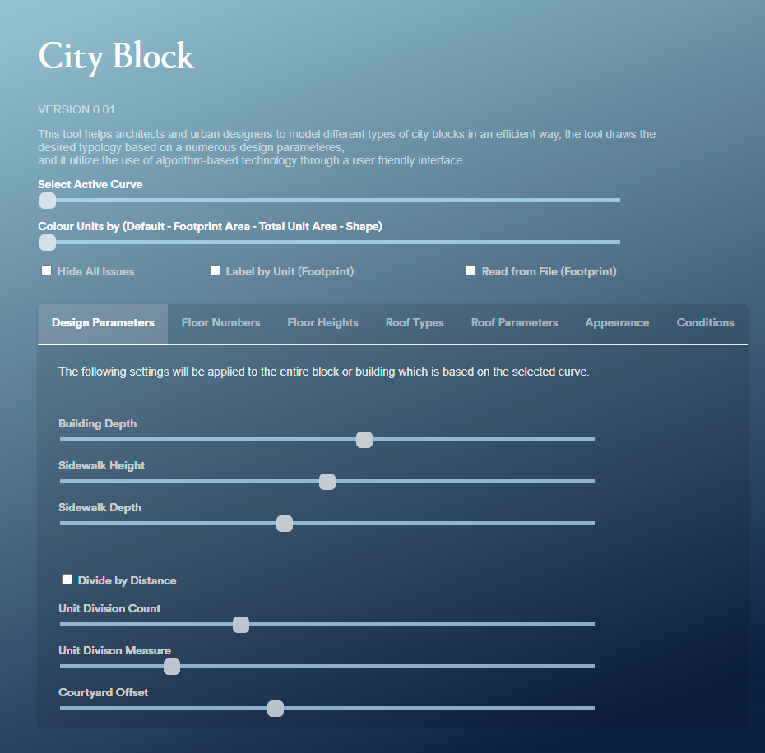
AAD & DAD
COMPLEX SCRIPTS
USER FRIENDLY INTERFACE
Grasshopper + Python
Locally or Web Based
1
Control
2
Enjoy

